Slide 1
GENERATING IMAGE USING DIFFERENT AI TOOLS
AVIATION MANAGEMENT

Slide 2
PROMPT USED
Create a photorealistic professional aviation operations scene at a major international airport. Show airport operations staff coordinating aircraft turnaround activities on an active apron, including ground support equipment, baggage loading, passenger boarding, aircraft servicing, ground crew communication and safety procedures. Include a modern passenger aircraft positioned at the gate with realistic airport infrastructure in the background. Use professional aviation documentary photography, realistic daylight, accurate proportions, authentic ground-handling equipment, natural human poses, realistic safety clothing, cinematic depth of field, highly detailed textures, no distorted people, no fictional logos, no unnecessary text, 16:9 aspect ratio.

Slide 3
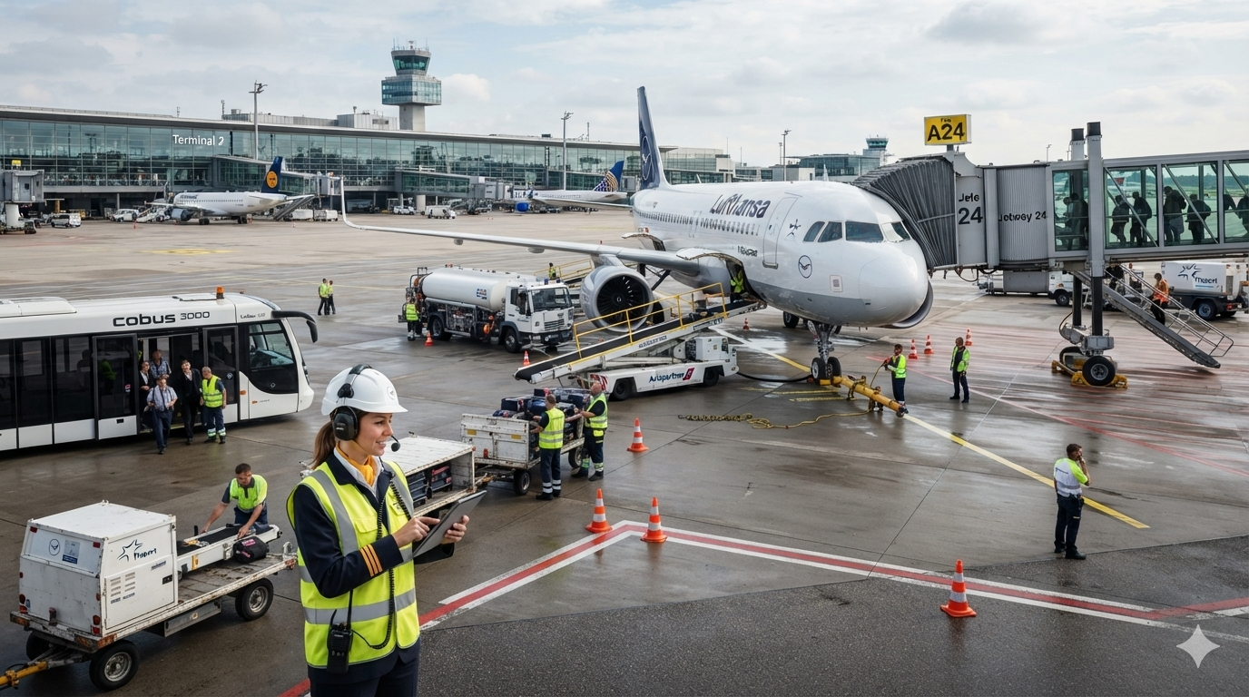
TOOL 1 : NANO BANANA

Slide 4
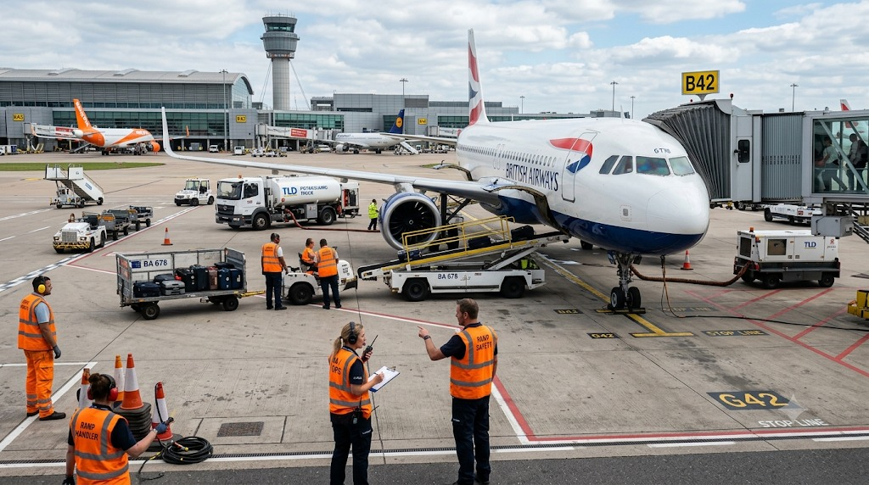
TOOL 2: IDEOGRAM

Slide 5
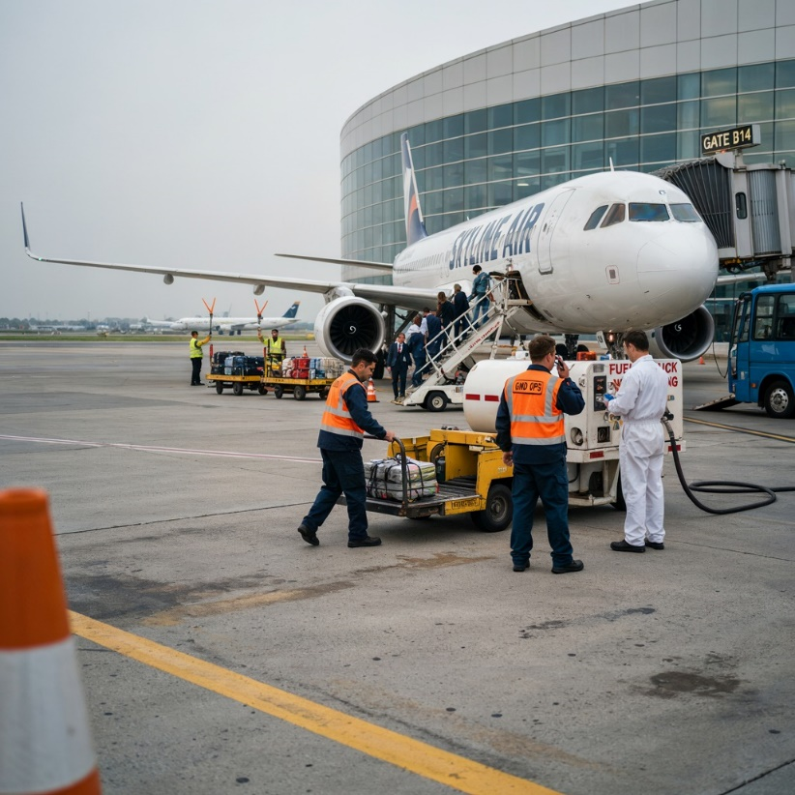
TOOL 3 : FLUX. 2 PRO

Slide 6
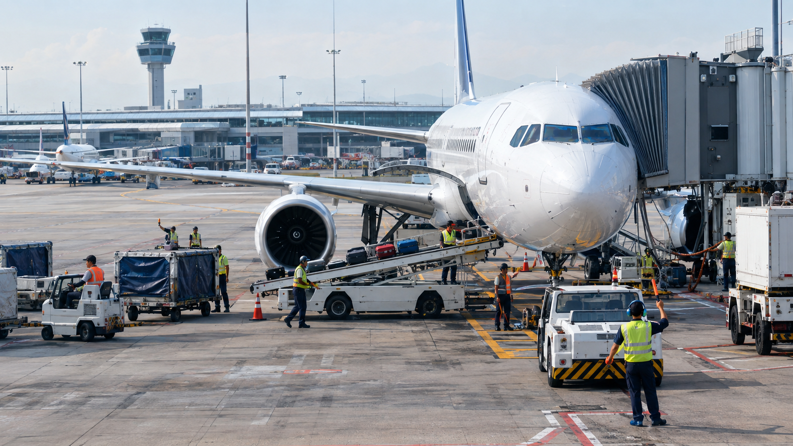
TOOL 4: CHATGPT

Slide 7
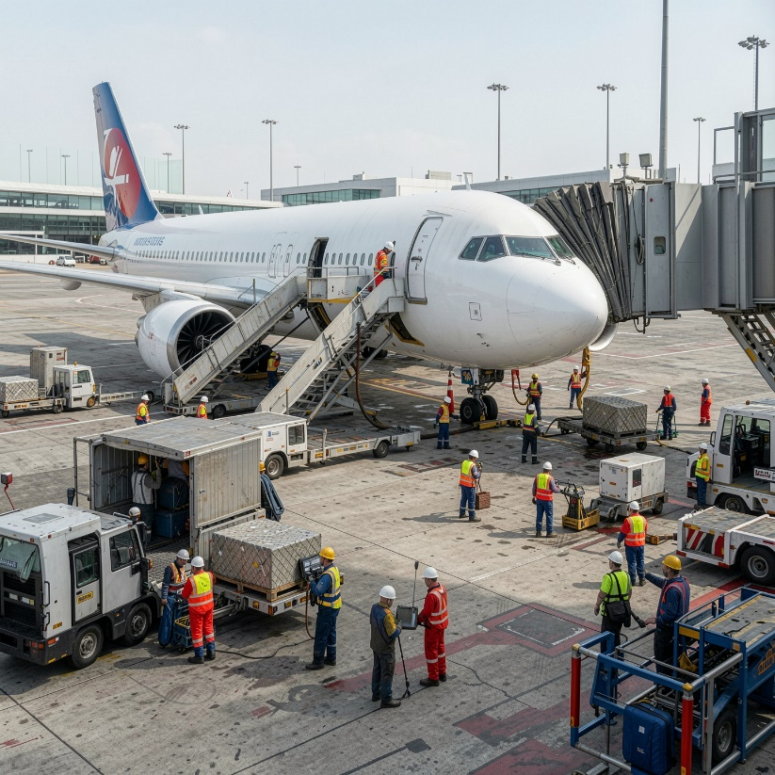
TOOL 5 : GAMMA AI

Slide 8
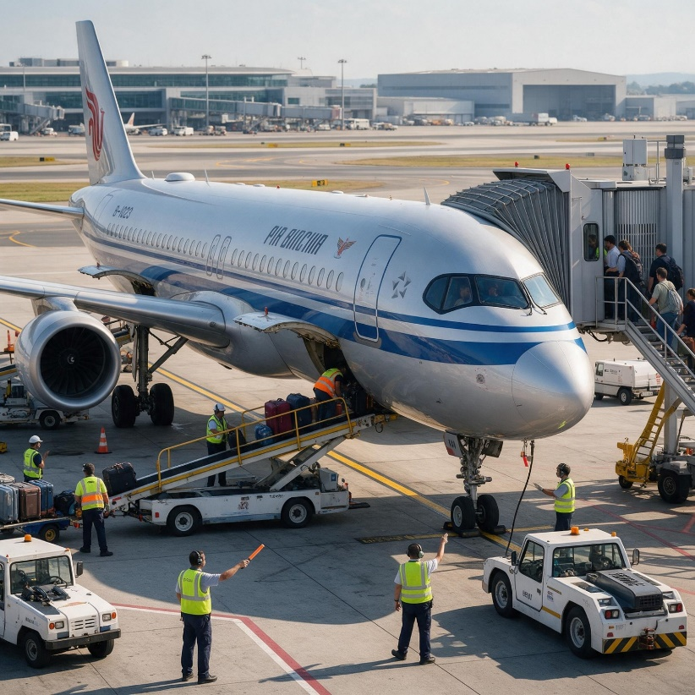
TOOL 6 : HIGGSFIELD

Slide 9
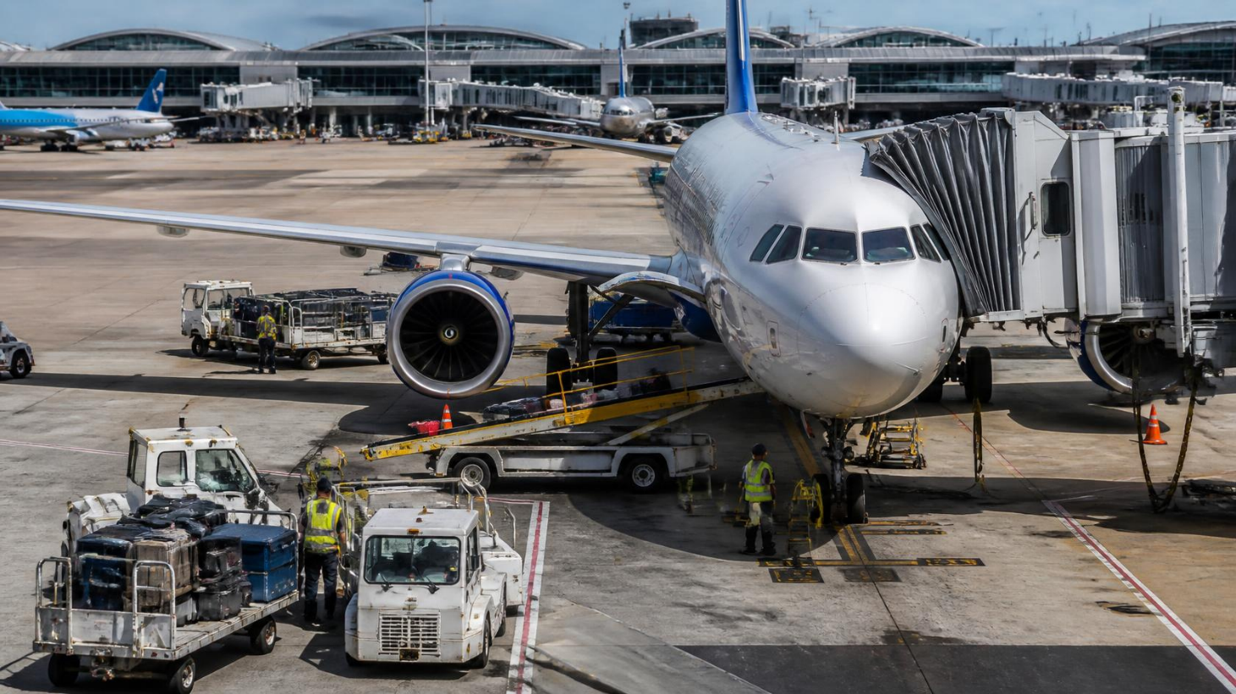
TOOL 7 : CANVA AI

Slide 10
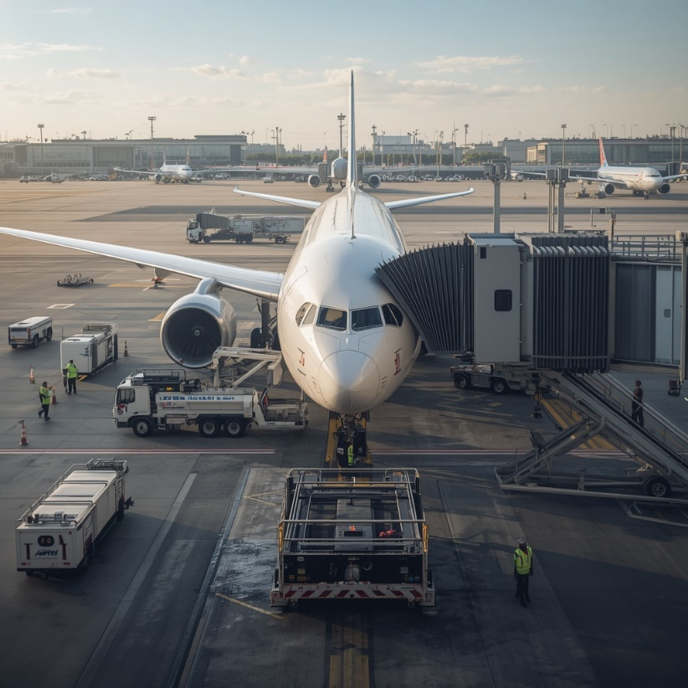
TOOL 8 : LEONARDO AI

Slide 11
PRESENTED BY
JYOTI, DHARVI, JIGYASA, VARNIKA, ANSHUL, GOURAV

